Slide 1

CS 643 Project Presentation
Stack Overflow Data Insights
Team 1
Dhwanil Desai
Himanshu Patel
Samarth Desai
Valmik Kalathia
12/11/2019

Slide 2
Motivation
Stack Overflow is the largest online community for programmers to learn, share their knowledge, and advance their careers.
XML compressed dataset (~42 GB) includes an archive of Stack Overflow content, including posts, votes, tags, and badges.(link)
Community is growing strong over the last decade
More and more people are engaging on the platform and sharing solutions to various problems posted by users (students/developers) around the globe.
We are curious to see how users are engaging on the platform and want to find those statistics to see how stack overflow has changed over the year for users from 2008 to 2019

Slide 3
About Dataset (Compressed ~42 GB, Uncompressed 200+ GB)
Table | Size | Number of Rows
Users | 1.62 GB | 10,932,295
Tags | 2.18 MB | 55,665
Badges | 1.37 GB | 32,450,580
Comments | 13.17 GB | 75,437,848
Votes | 5.29 GB | 75,437,848
Posts | 29.36 GB | 31,017,889
Post History | 87.11 GB | 121,191,152
Post Questions | 29.13 GB | 18,154,493
Post Answers | 22.27 GB | 27,665,009

Slide 4
Design and Implementation
Task 1: Dataset extraction & conversion
XML to CSV , XML to JSON
Picked CSV, then JSON
Task 2: Selecting the cloud platform
Picked GCP as it provided $300 credits
Needed 10 hour runtime for converting XML data to CSV format.
Dataset size after extraction and conversion ~200 GB
Task 3: Loading the data into Google Cloud Storage Bucket
After downloading the dataset in the storage & ran couple of tests.
The data seemed in usable condition to run analysis.
Notes:
2 Parallel pocessing

Slide 5
Design and Implementation
Task 4: Load data in Spark and Hive
Setup cluster environment to run spark sql queries
Load data from Bucket to Cluster
Task 5: Running SQL Queries and Performance Analysis
Run queries on clusters of different size
Check for fault tolerance
Task 6: Generate Graphs for conveying results
Copy generated results from Spark SQL
Generate graphs using google sheet for better visualization purpose
Notes:
Add more points

Slide 6
INSIGHT - 1

Slide 7
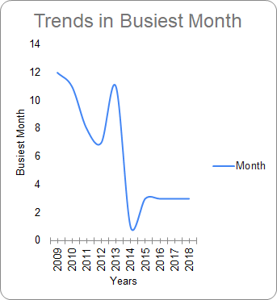
Finding the busiest month
Notes:
Mention query details

Slide 8
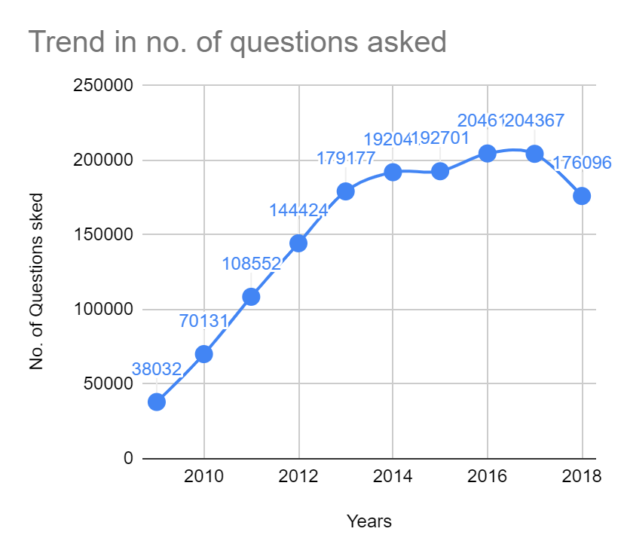
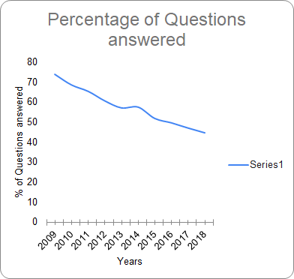
Analysis of the Busiest Month

Slide 9
INSIGHT - 2

Slide 10
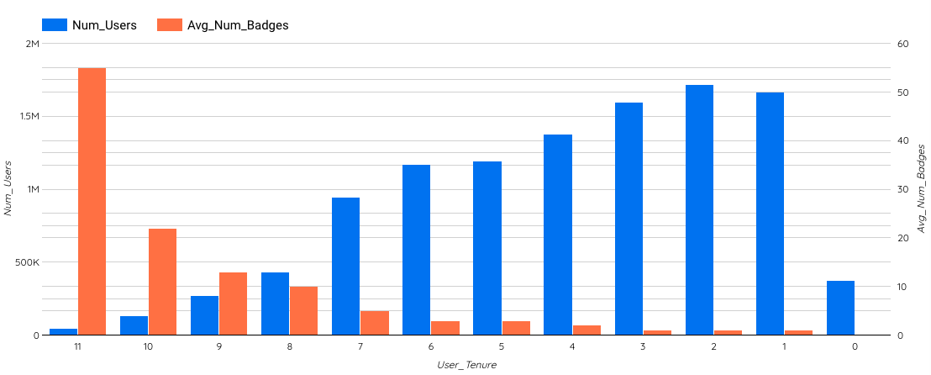
Avg number of Badges based on Tenure

Slide 11
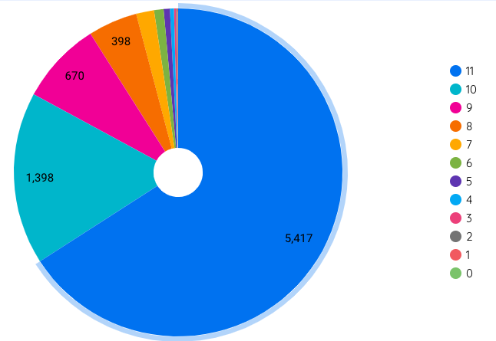
Tenure-wise average
Reputation count

Slide 12
INSIGHT - 3

Slide 13
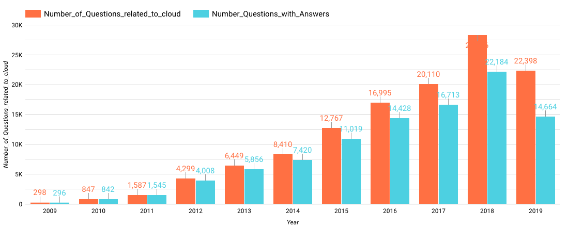
Growth of Cloud

Slide 14
INSIGHT - 4

Slide 15
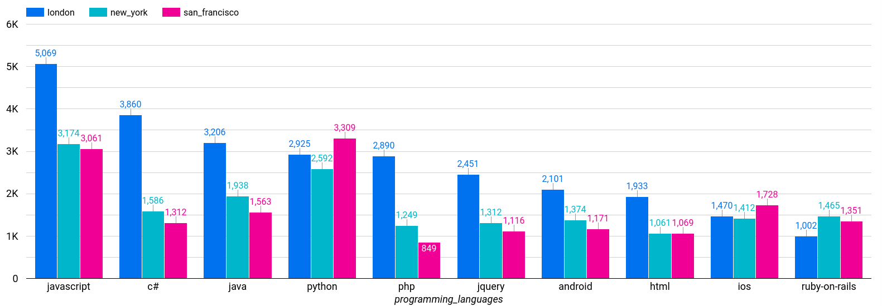
Tech Question Frequency in Different Cities
Notes:
These are top 10 common frequent languages

Slide 16
INSIGHT - 5

Slide 17
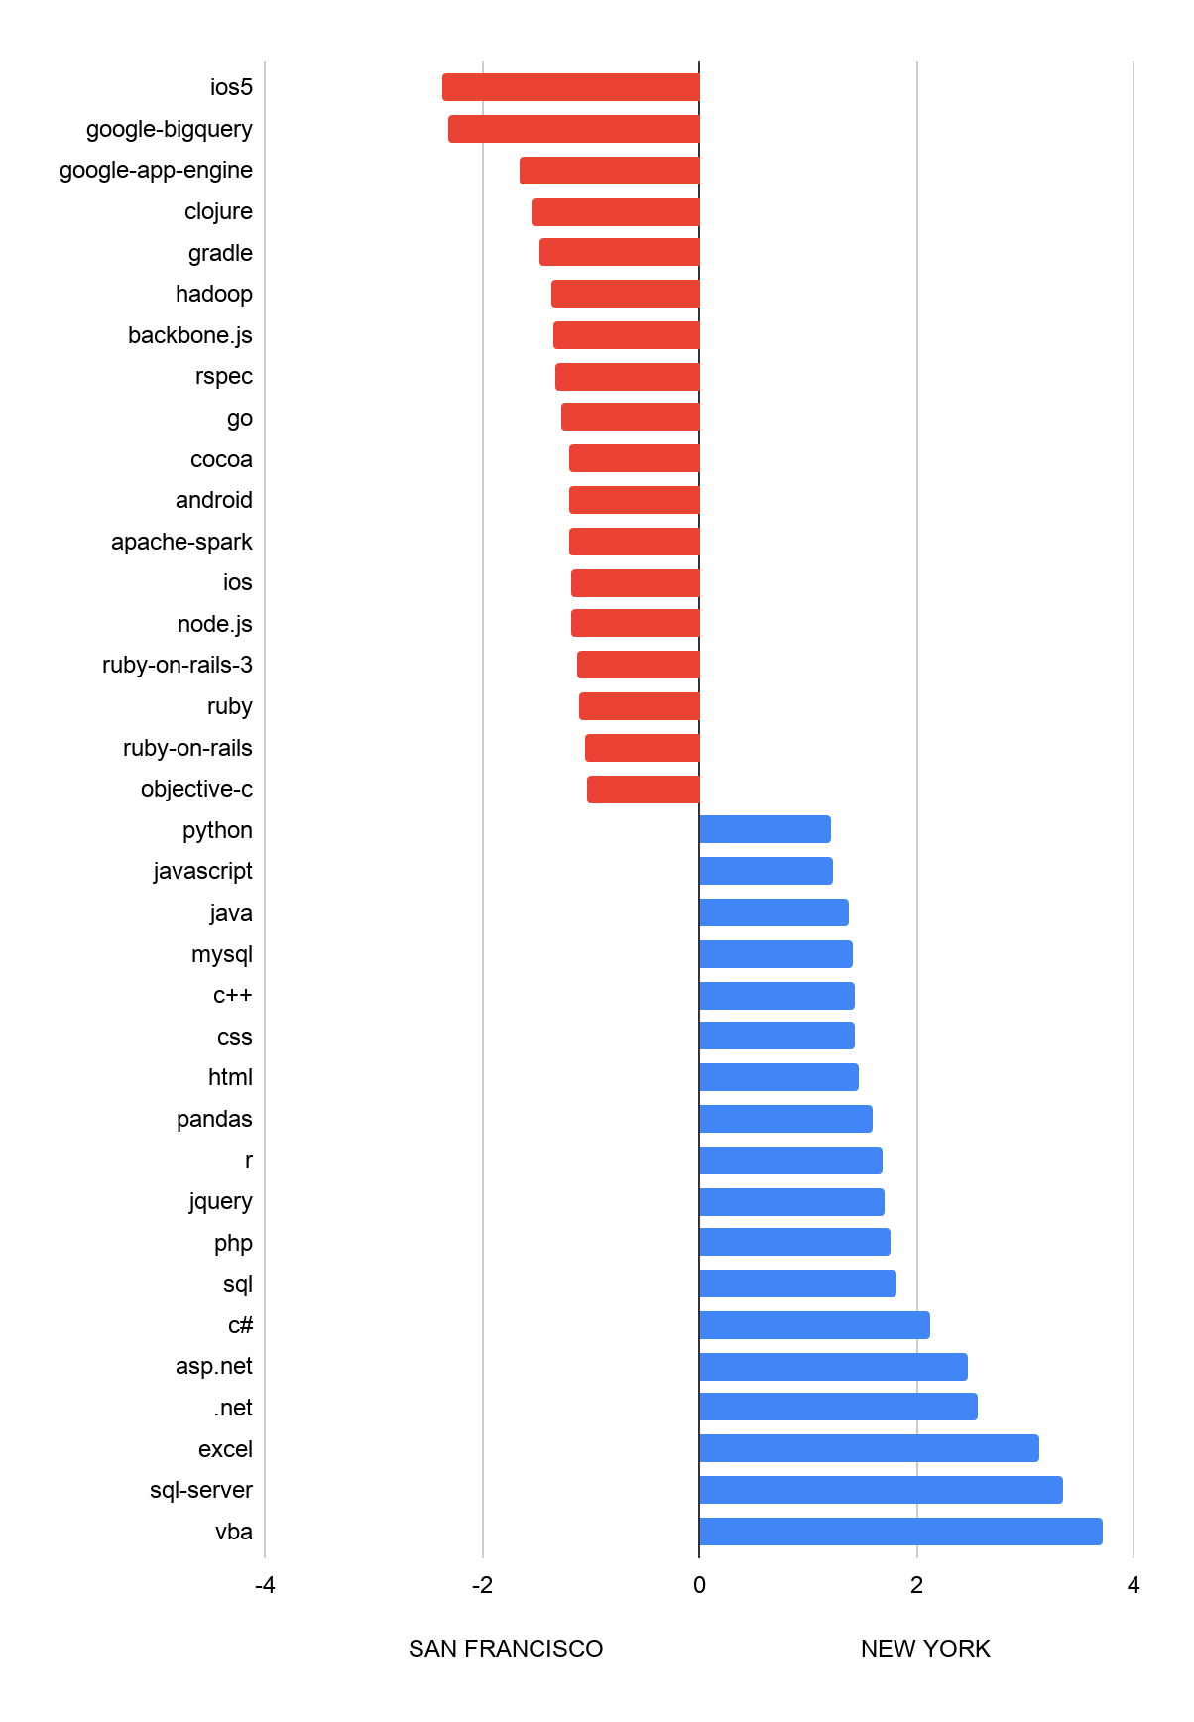
Topics popularity
NY vs SFO comparison
Notes:
Most of these common technologies look like they make up a fairly similar fraction of NY and SF traffic, but we’re interested in stark differences. What tags (among the 200 most high-traffic tags) showed the largest difference between San Francisco and New York?
One clear difference: New York has a larger share of Microsoft developers. Many tags important in the Microsoft technology stack, such as C#, .NET, SQL Server, and VB.NET, had about twice as much traffic in New York as in San Francisco.
There are also patterns in the technologies that are more common in the San Francisco area, especially languages developed by Apple (Cocoa, Objective-C, OSX) and Google (Go, Android). We can also see several influential open source projects, especially ones associated with Apache (Hive, Hadoop, Spark).
Rather than looking only at the most dramatic changes, we could visualize the SF/NY ratio compared to the total visits:

Slide 18
PERFORMANCE ANALYSIS

Slide 19
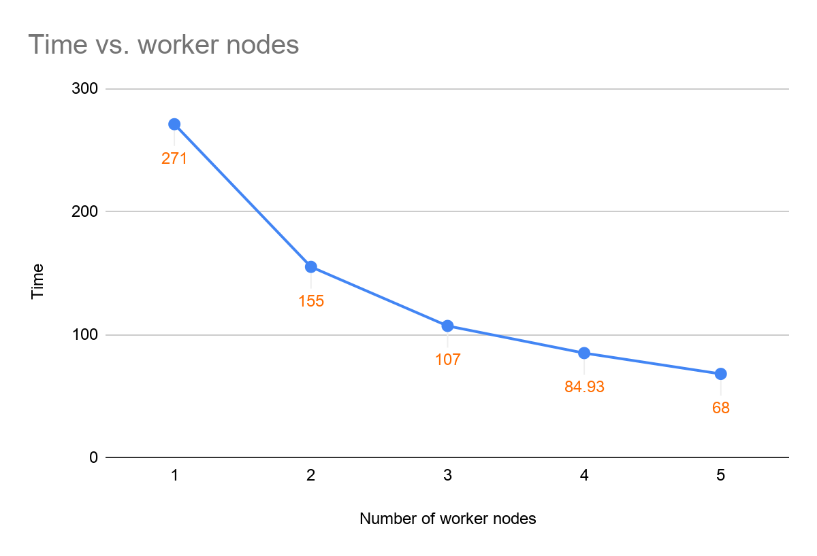
Scalability

Slide 20
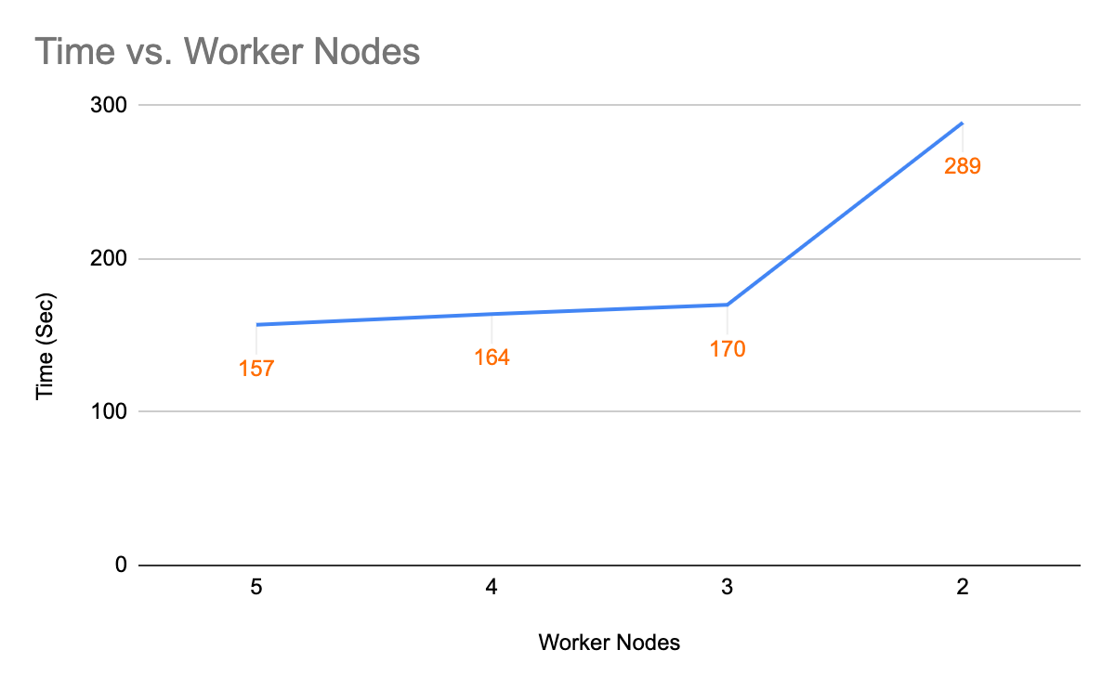
Fault Tolerance

Slide 21
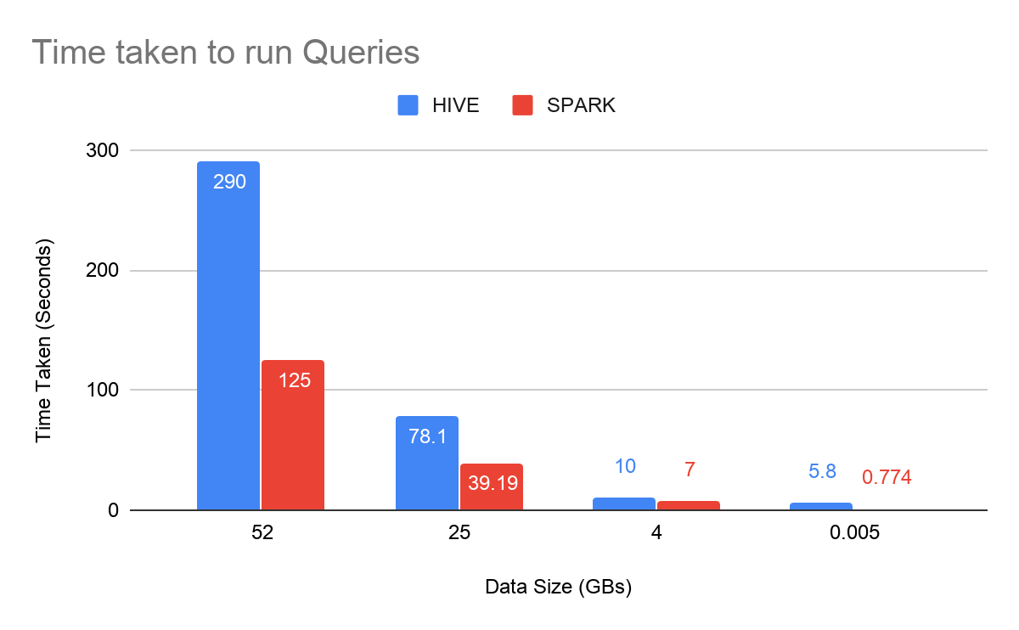
Hive Vs. Spark

Slide 22
Individual Contribution
Dhwanil Desai
Worked on Insight 2 and 3
Did performance Analysis on Fault Tolerance
Cluster Configuration
Data Processing and Cleaning
Valmik Kalathia
Worked on Insight 4
Helped with Visualisation
Cluster Configuration
Samarth Desai
Worked on Insight 1
Helped with Visualisation
Cluster Configuration
Data Processing and Cleaning
Himanshu Patel
Worked on Insights 5
Did performance Analysis on Scalability
Cluster Configuration
Data Processing and Cleaning

Slide 23
Thank You
There are only two kinds of languages: the ones people complain about and the ones nobody uses. - Bjarne Stroustrup

